Slide 1
INSIGHTS FROM A LEADING BANKS
BY
S.ANITHA
P.ABINAYA
G.ARCHANA
M.ARUNA

Slide 2
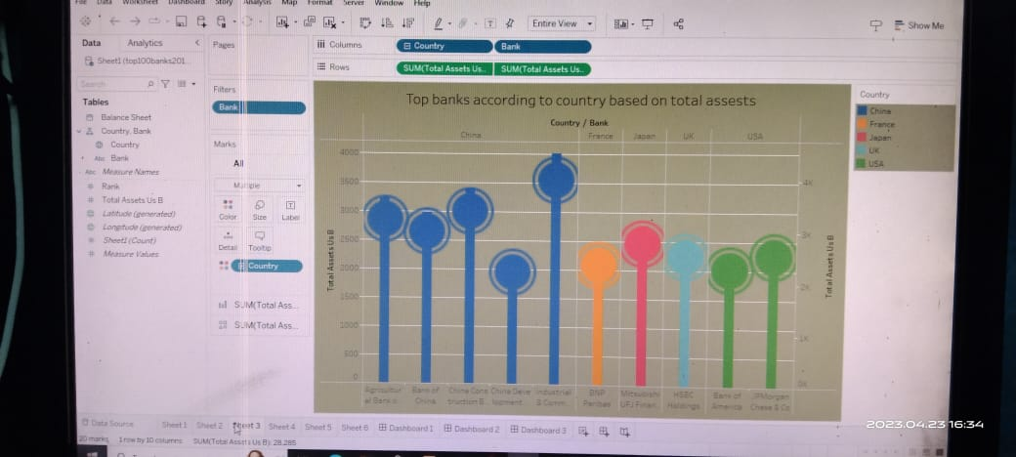
Insights from a leading banks
The banking industryworld wide isbeing transformed .In addition recent banking crises in Asia and Latin America have accentuated. these process.

Slide 3
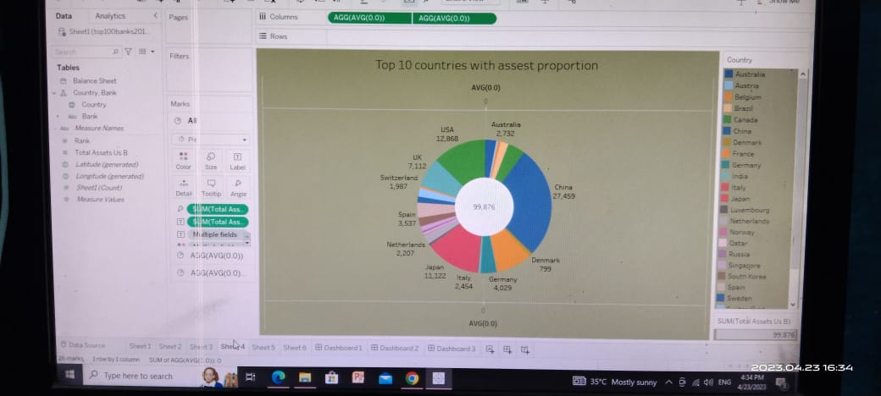
Data collection and extraction from data base
Introduction :
Data collection is the process of gathering and measuring information on variable of interest in an established systematic fashion and genarate insights from the data.
This data helps us to make the data easily understandable and ready for creating visualisation to gain insights from the perfomance and efficiency..

Slide 4
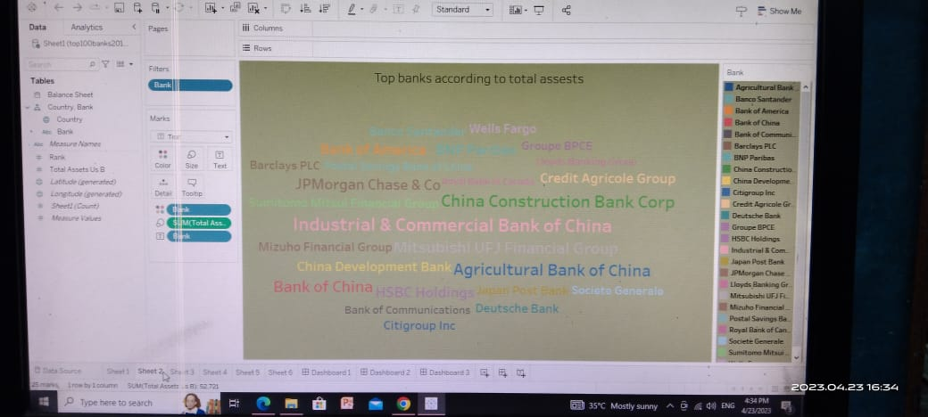
Data preparation
This process helps us to make the data easily understandable and ready for creating visualisation to gain insights into the perfomance and efficiency.

Slide 5
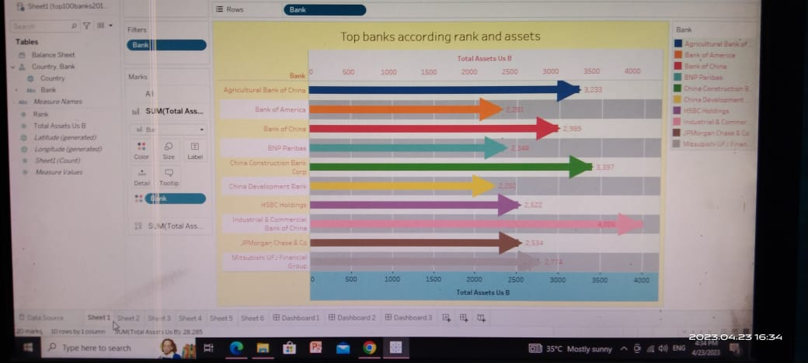
No of unique visualization
The number of unique visualization that can be created with a given dataset .
That can be used to efficiency of banks include bar charts,line charts,scaller pots etc.

Slide 6
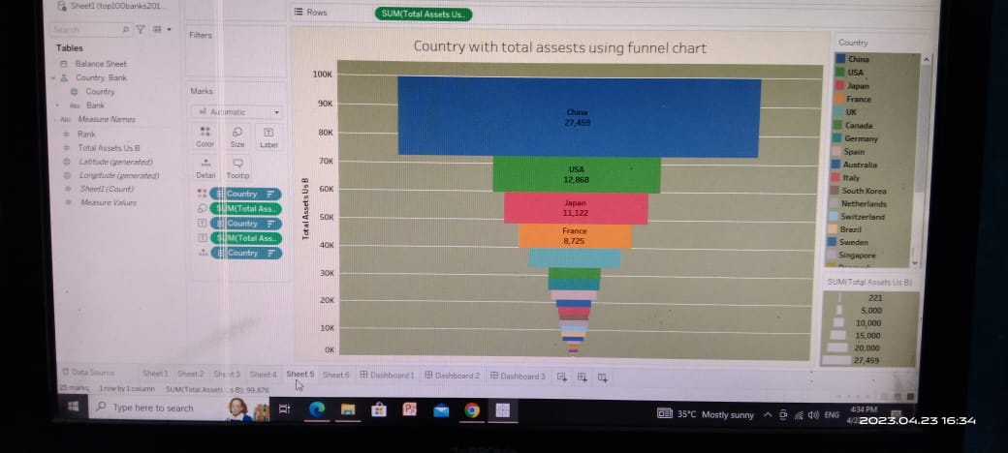

Slide 7
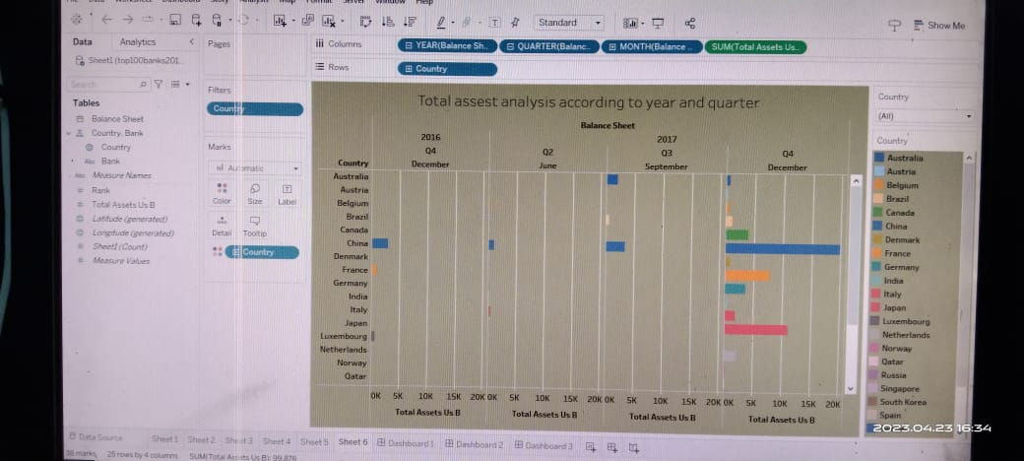
Responsive and design of dashboard
And ,finally they can be used to track key performance indicators , monitor performance metrics and display data in the form of charts
THANK YOU.

